Slide 1
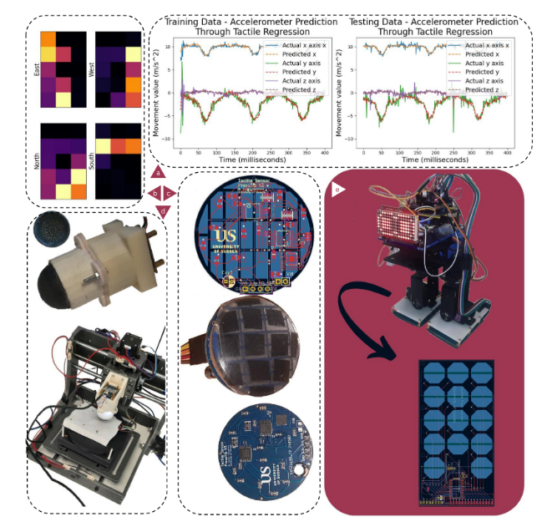

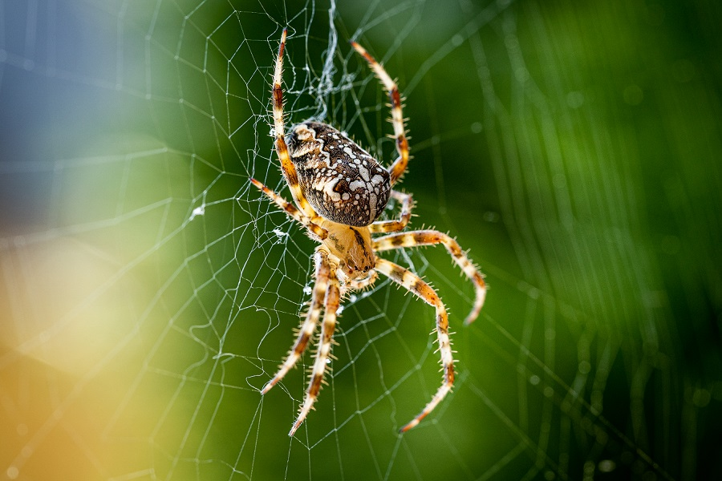
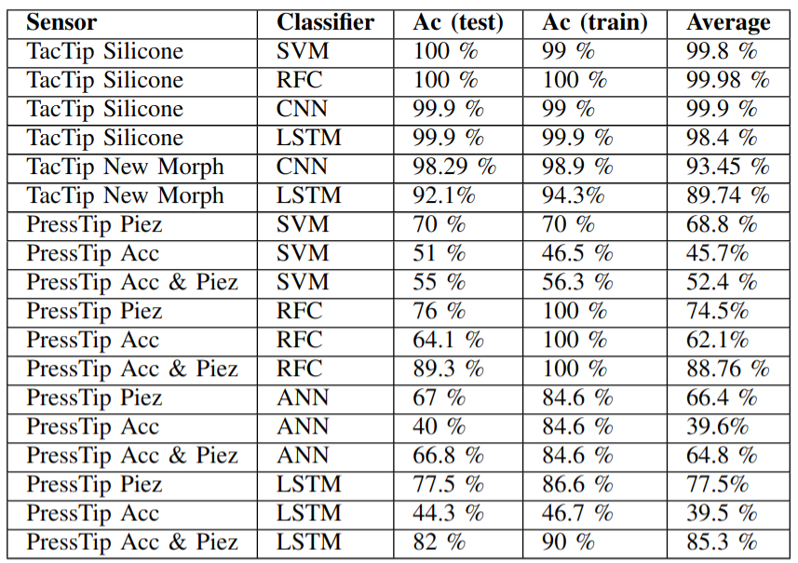
The Presstip: A Hybrid Soft Tactile Sensor for Robot Pose Estimation and Texture Classification
How important is resolution to skin-inspired tactile sensing?
?

